Slide 1



신재생 에너지
컴퓨터공학부 이효준

Slide 2
For What?
Solar energy service !
SolarCity markets, manufactures, and installs residential and commercial solar panels in the US.

Slide 3

History
(2006) Lyndon Rive make “solar city”
(2009) 440+ Mw
[2013] GTM RESEARCH- 2ND in solar energy

Slide 4
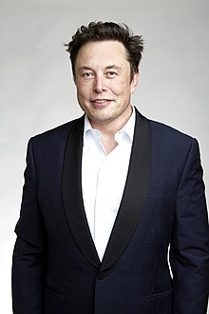
History
[2014] 6200+ MW
[2015] 870MW : 28% of solar energy
[2016] Merged into tesla

Slide 5
business
Solar Leasing [2008]
Commercial Solar [2008]
Electric vehicle Charger [2011]

Slide 6
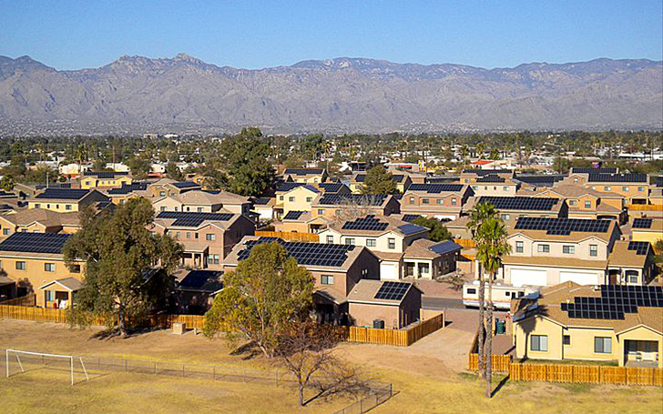

Solarstrong project
120,000 housing units
Up to 300MW solar energy

Slide 7
Why solarcity?
Install
[2013]
Efficiency
[2010]
Storage
[2016]
SolarCity

Slide 8

"The Secret Tesla Motors Master Plan"

Slide 9
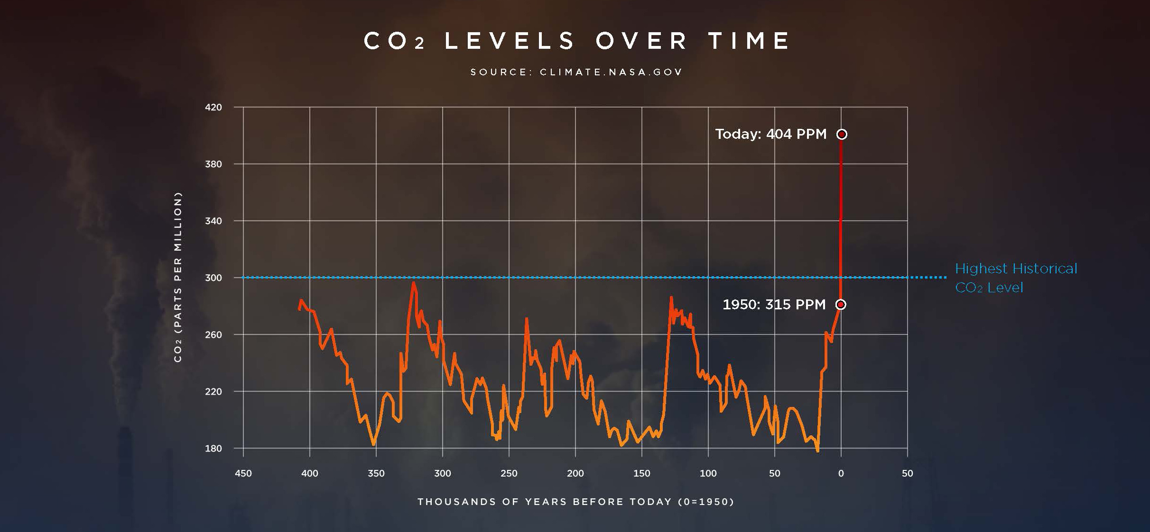
“sustainable energy company"
Generate
Storage
Transport

Slide 10

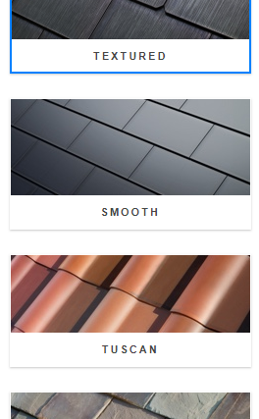
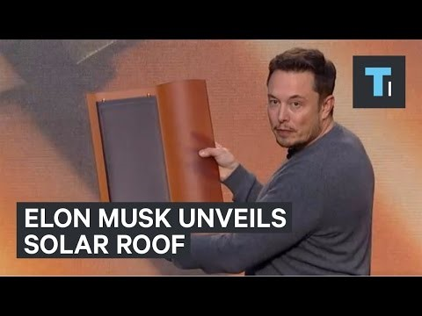
tesla solar roof + Powerwall 2

Slide 11

Q & A

